Slide 1
Radio Frequency Signal Generator
By: Ethan Cura, Abel Gonzalez, Joseph Hinz and James Taylor
Notes:
James

Slide 2
Purpose
The goal of this project is to supplement the existing market with a low-cost RF signal generator for students and enthusiasts.
Notes:
James

Slide 3
Technical Summary
The signal generator shall have a frequency range between 1 and 500MHz with 1Hz precision.
The signal generator shall be able to frequency and amplitude modulate this carrier frequency.
The signal generator shall minimize any spurious signals for a spectrally pure output.
Notes:
Abel

Slide 4
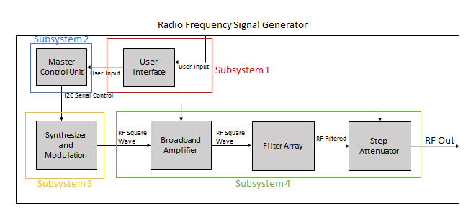
System Overview
Subsystem 1: Ethan Cura
Subsystem 2: Abel Gonzalez
Subsystem 3: Joseph Hinz
Subsystem 4: James Taylor
Notes:
Ethan

Slide 5
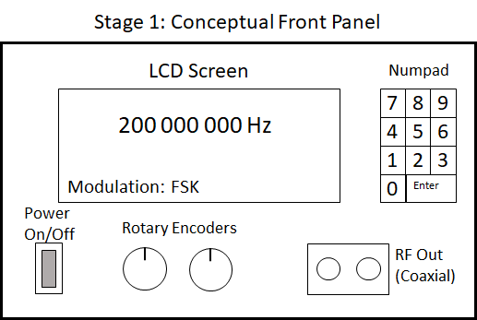
Subsystem 1: User Interface

Slide 6
Subsystem 1: Integration
Design/buy a simple metal housing to mount instruments
Redesign UI board in order to allow UI elements to mount to the front panel
Design a MCU board that will interface with the LaunchpadXL and connect the MCU board to the UI board and all subsystems
The MCU board will also distribute power to all other boards

Slide 7
Subsystem 1: Integration Progress
We now have a metal housing in which all boards will eventually be mounted
Schematics for the MCU board and the UI board have been developed
Board layouts for each of these will be done and sent for fabrication within the week

Slide 8
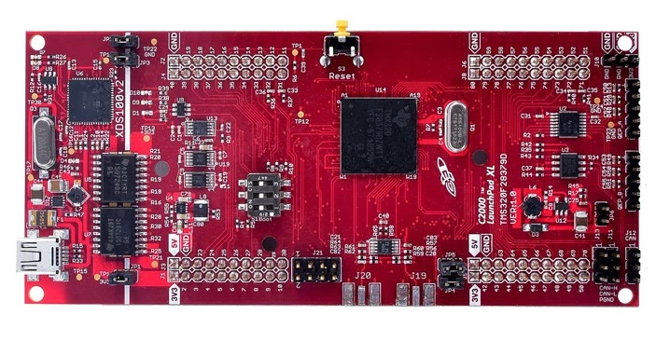
Subsystem 2: Master Control Unit
Notes:
Controls the synthesizer, modulation, filter selection, and appropriate attenuation
Abel

Slide 9
Subsystem 2: Integration
Develop code that will allow the MCU to interface with digital I/O such as the rotary encoders and numpad
Develop code that will allow the MCU to communicate/control I2C components such as the character display and synthesizer
Develop a menu that allows the user to control the completed device through the UI

Slide 10
Subsystem 2: Integration Progress
Basic control code has been developed to read and write to pins
Basic I2C control code has been developed and tested successfully on real components
Further development is needed to communicate with rotary encoders and numpad. I2C communication with LCD and Si570 synthesizer still needs to be developed.

Slide 11
Subsystem 3: Integration
Subsystem 3 will be controlled via I2C through a ribbon cable from the MCU board
Power will also be supplied from the MCU board
The output of subsystem 3 will be passed to Subsystem 4 through a coaxial cable

Slide 12
Subsystem 3: Integration Progress
At this point Subsystem 3 works as intended
Communication through I2C has been tested successfully using a different MCU control board (Arduino)
Output signal from Subsystem 3 through a coaxial cable has been successfully tested
Power connection to MCU board will be accomplished using two jumper wires connected to the MCU board.

Slide 13
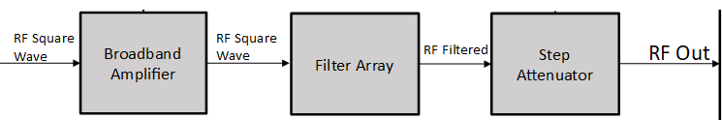
Subsystem 4: Broadband Amplifier/Filter Array/Step Attenuator
Amplifier increases the power of the carrier/modulated signal
Filters remove unwanted harmonics from square wave signal to produce a sinusoidal carrier
Attenuators reduce signal power to the user defined output power
Notes:
James

Slide 14
Subsystem 4: Integration
Subsystem 4 will be controlled via I2C through a ribbon cable from the MCU board
Power will also be supplied from the MCU board
The output of subsystem 4 a coaxial terminal

Slide 15
Subsystem 4: Integration Progress
Amplifier and filter boards (but not the attenuator board) have been fabricated
Two of the filter boards and the amplifier board are mostly assembled
Frequency response of filter boards 1 and 2 has been tested, amplifier board needs debugging
Notes:
James

Slide 16
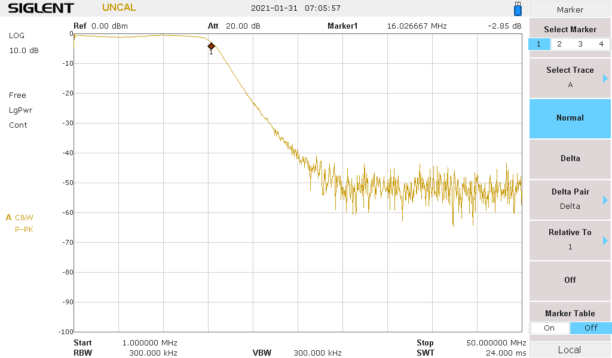
Results (8-16MHz)
Notes:
James

Slide 17
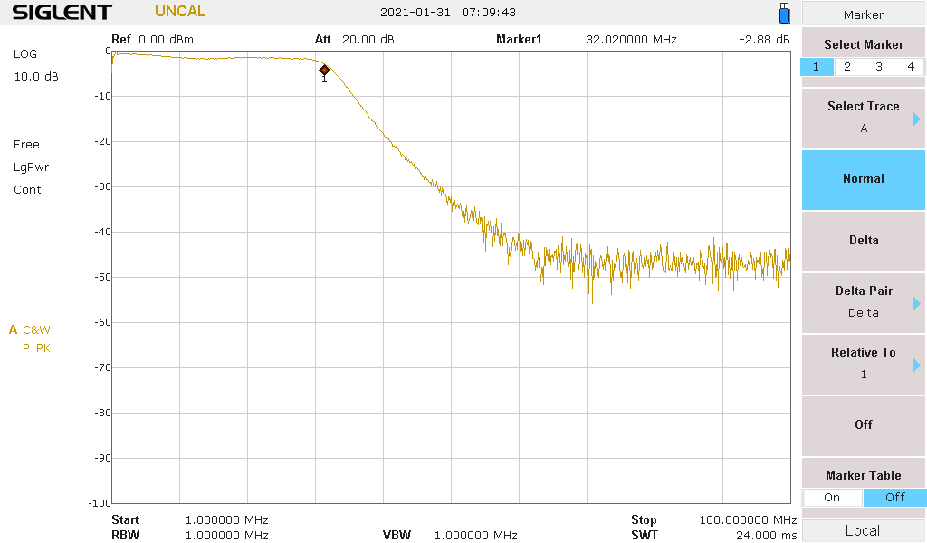
Results (16-32MHz)
Notes:
James

Slide 18
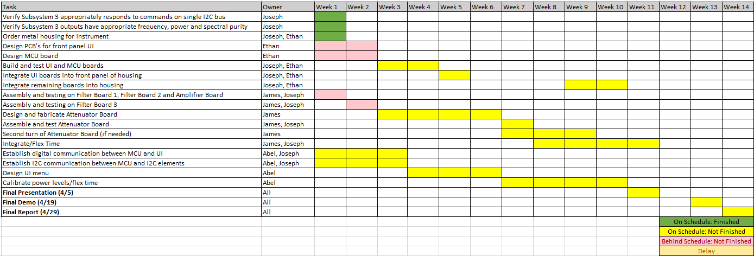
Integration Timeline

Slide 19
Validation Results
No results from Subsystem 3 at this time
Code has been developed on the MCU that allows basic I2C commands to be sent
Code has been developed on the MCU that allows reading and writing to GPIO pins
A schematic for the MCU board which will interface the UI and MCU to the other subsystems has been drafted with a board layout soon to follow
A schematic for the UI board has also been drafted with a board layout soon to follow
Two filter boards and the amplifier board have been built on their PCBs (except for one component that needs to be ordered)
Second filter board has been tested and shows intended frequency response

Slide 20
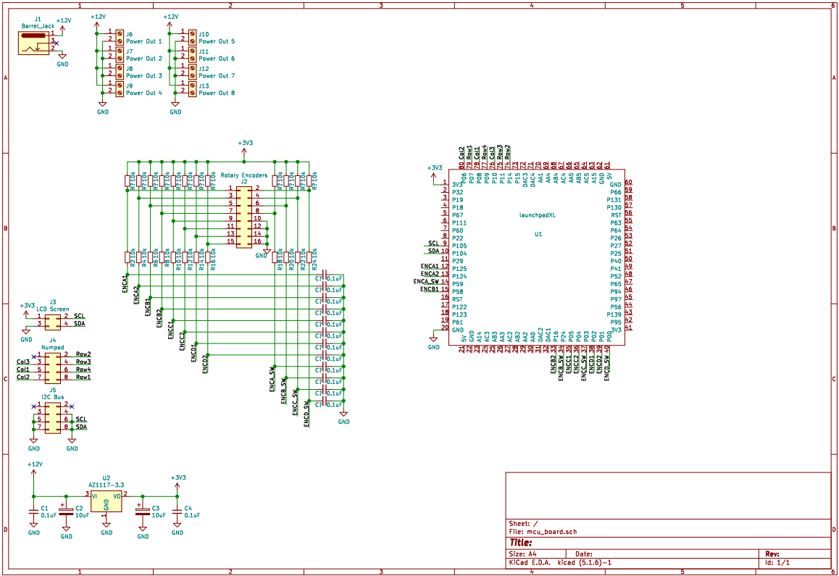
Subsystem 1: MCU Board Schematic

Slide 21
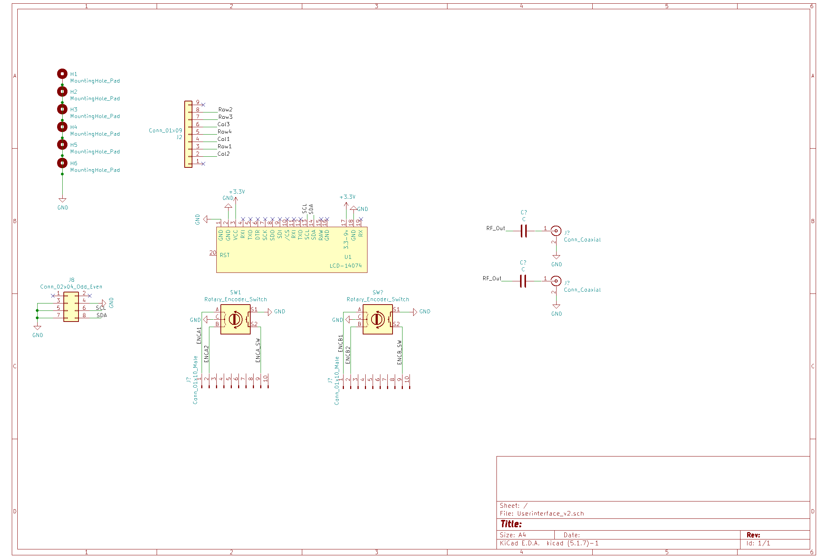
Subsystem 1: UI Board Schematic

Slide 22
Questions

Slide 23
Thank You

